Slide 1
IC Design HW2 Tutorial
Yi-Hsiang Chen
Advisor: Tzi-Dar Chiueh
Oct. 23 2012

Slide 2
Outline
Connect to workstations
Flow chart
Cadence tool
Post-layout simulation tool
Debug tool
Reminder

Slide 3
Connect to Workstations
PuTTY
Xming
SSH (SFTP)

Slide 4
Preparatory Works
Download and install program of PuTTY
http://the.earth.li/~sgtatham/putty/latest/x86/putty.exe
We will use putty to connect to workstation
Download and install program of Xming
http://ncu.dl.sourceforge.net/project/xming/Xming/6.9.0.31/Xming-6-9-0-31-setup.exe
http://sourceforge.net/projects/xming/files/Xming-fonts/7.5.0.25/Xming-fonts-7-5-0-25-setup.exe/download
Launch GUI in Linux Environments
Download and install SFTP software
SSH2 in Cuteftp
SSH in FileZilla (Recommended) http://filezilla-project.org/
Up/download files to/from workstation

Slide 5
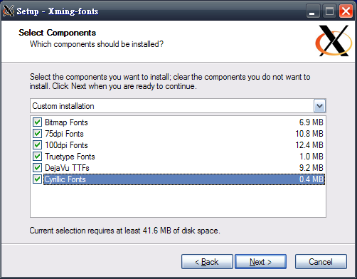
Launching Xming (1/2)
Install and Setup
Just click on “next” in each step

Slide 6
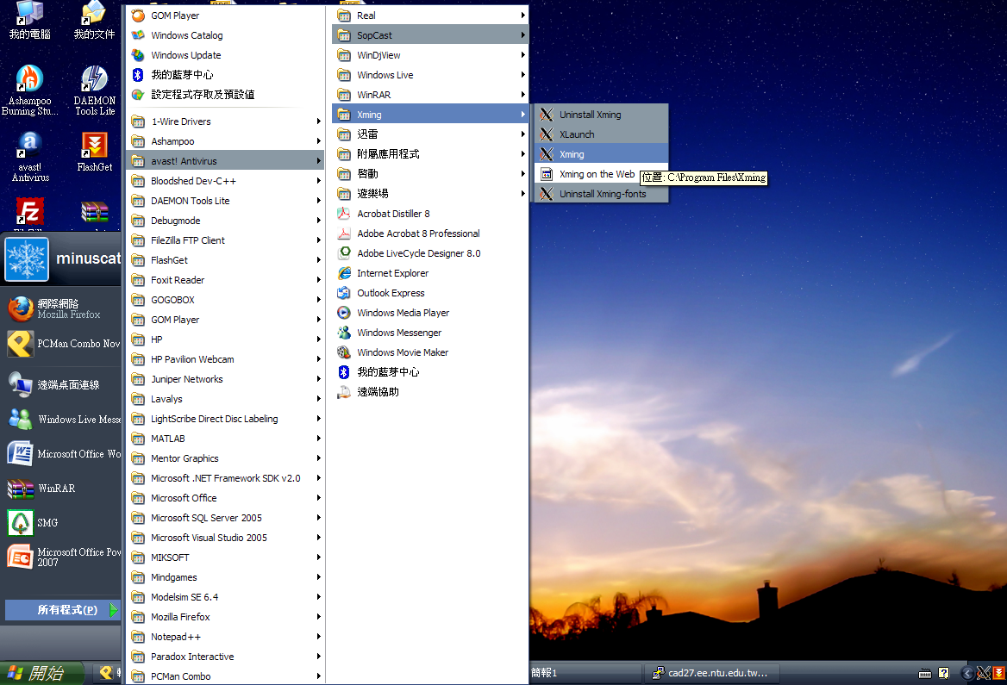
Launching Xming (2/2)
Launch Xming before using putty

Slide 7
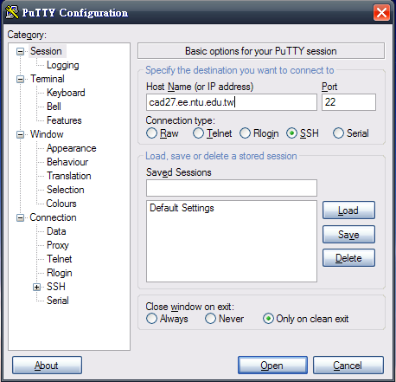
Launching PuTTY (1/2)
Workstation list: http://cad.ee.ntu.edu.tw/ws_list.htm

Slide 8
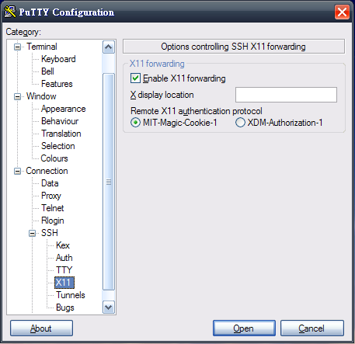
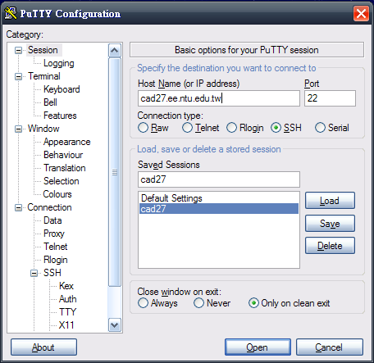
Launching PuTTY (2/2)
3
2
4
5
6
1
7

Slide 9
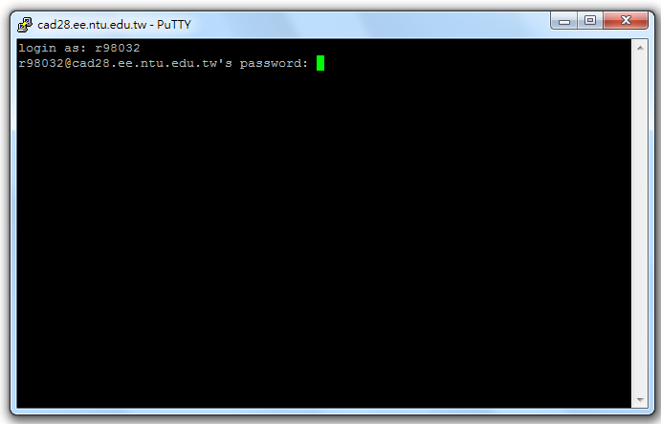
Log-In (1/2)

Slide 10
Log-In (2/2)
User Name
Ex: r98943032 -> r98032
b97901020 -> b97020
Ex: b96502040 -> b6502040
Password
Default: icd2012

Slide 11
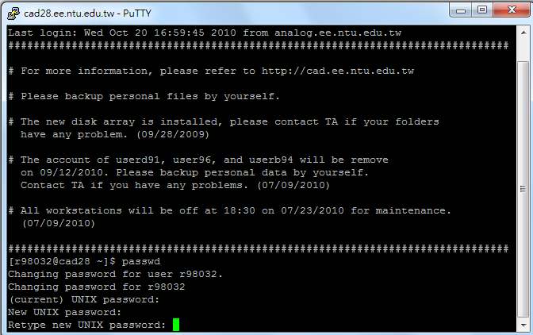
Change your password

Slide 12
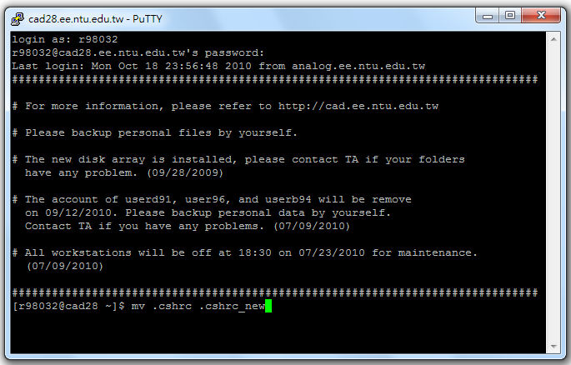
Change the environment file name
Change the name of .cshrc
mv .cshrc .cshrc_new
Otherwise, you can not connect to workstation by SFTP

Slide 13
SSH File Transfer Protocol (SFTP)
SFTP software
SSH2 in Cuteftp
SSH in FileZilla
Ex: FileZilla

Slide 14
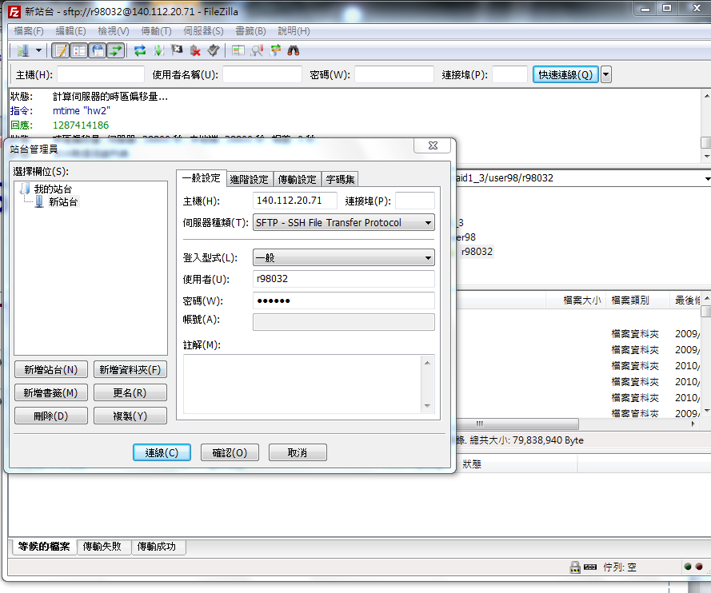
SSH in FileZilla (1/2)

Slide 15
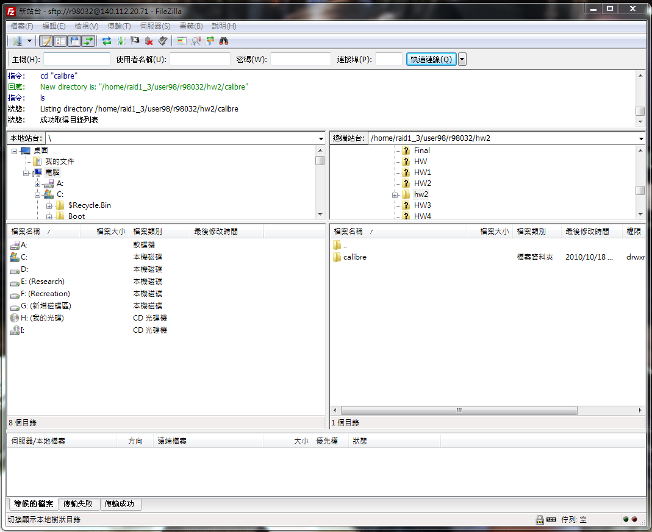
SSH in FileZilla (2/2)

Slide 16
Simple Linux command
Source the setting file
source
Change your password
passwd
Document management
cd [directory name/..]
ls [-a/-l]
mkdir [directory name]
cp [options] [source] [destination]
rm [-fir] [file/directory]
mv [-fiu] [source] [destination]
whereis/locate/find [file name]
Text Editor
vi or vim
View Ref[2] for more detail!

Slide 17
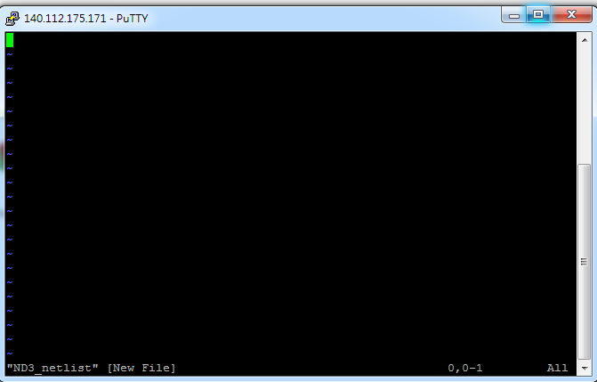
Vim

Slide 18
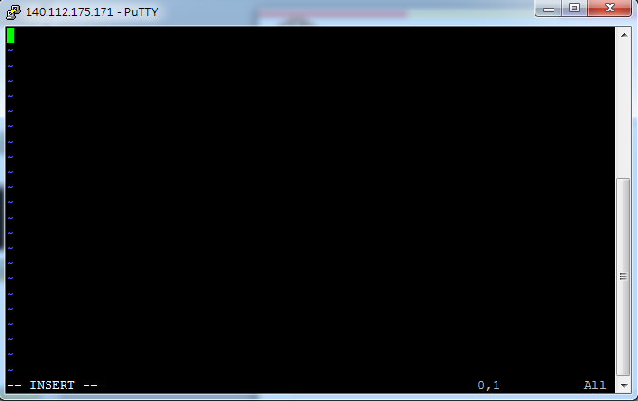
Vim (insert mode)
Press “I”

Slide 19
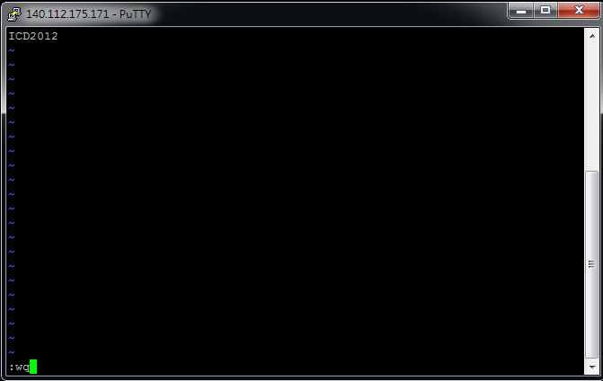
Vim
Enter “:wq”

Slide 20
Flow chart
.netlist .pex .pxi nn018.l
Cadence
Layout
*.fsdb
Calibre
Nanosim
nWave
Extraction
Post-layout simulation
Your job
(Write netlist)
netlist
Your job
(Give input)

Slide 21
Cadence Tools
SPICE language (Assemble transistors)
Layout parameter extraction

Slide 22
Source the needed files
Source your environment setting file
source .cshrc_new
Cadence tool
source /usr/cadence/cshrc
Calibre tool
source /usr/mentor/CIC/calibre.cshrc

Slide 23
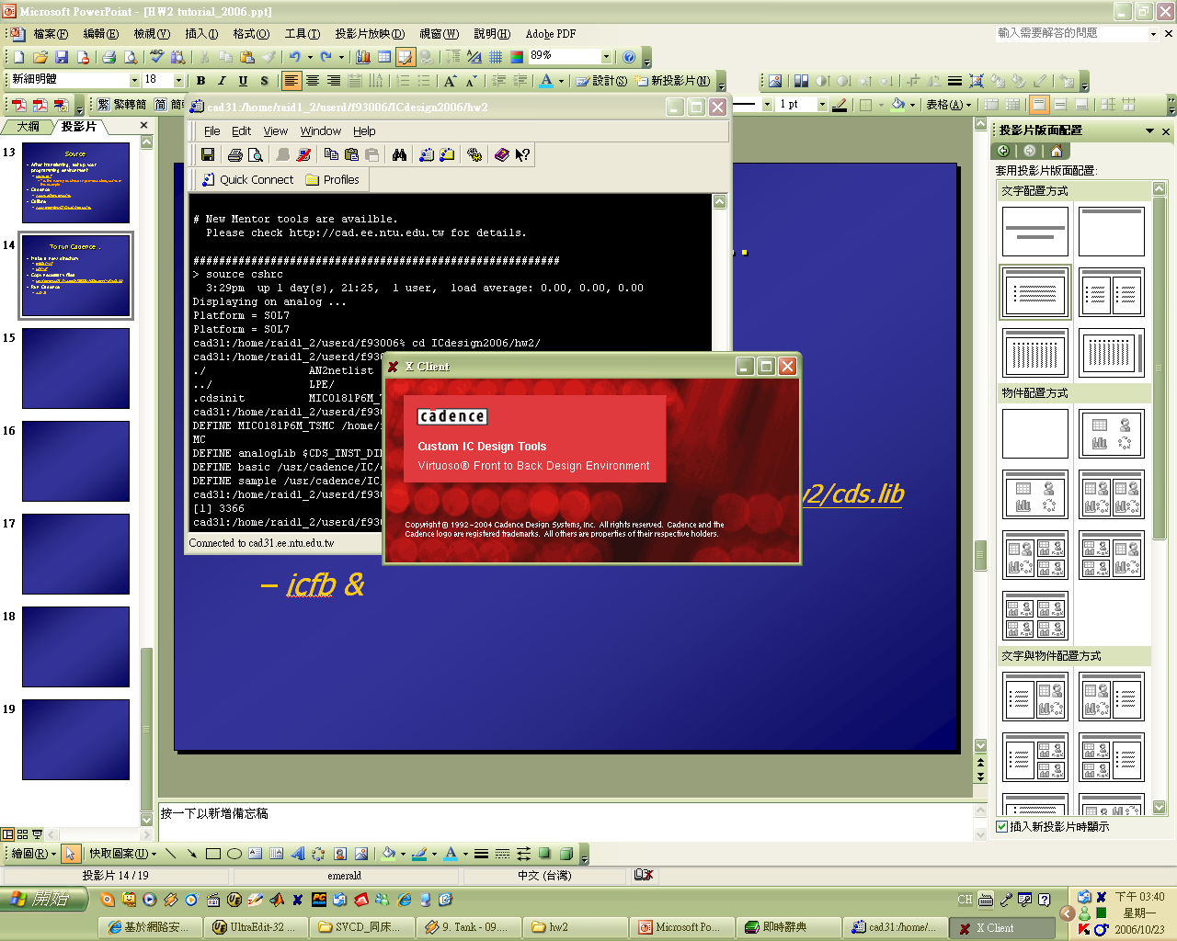
To run Cadence…
Your home directory
Make new dictionary
mkdir hw2
cd hw2
mkdir calibre
cd calibre
Copy necessary file
cp /home/raid2_2/course/icd/cds.lib .
cp /home/raid2_2/course/icd/display.drf .
cp /home/raid2_2/course/icd/.cdsinit .
cp /home/raid2_2/course/icd/lpe.cmd .
Run cadence
icfb &
…
hw2
…
calibre
Remember to create an individual directory “calibre”
because Calibre will produce many temporary files.

Slide 24
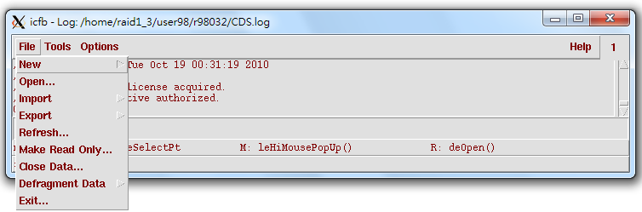
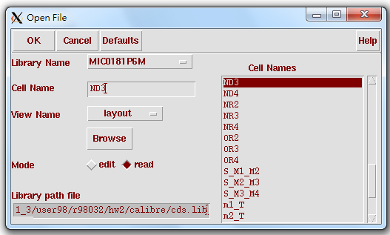
Open a layout (1/2)
File → open

Slide 25
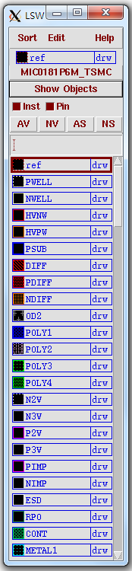
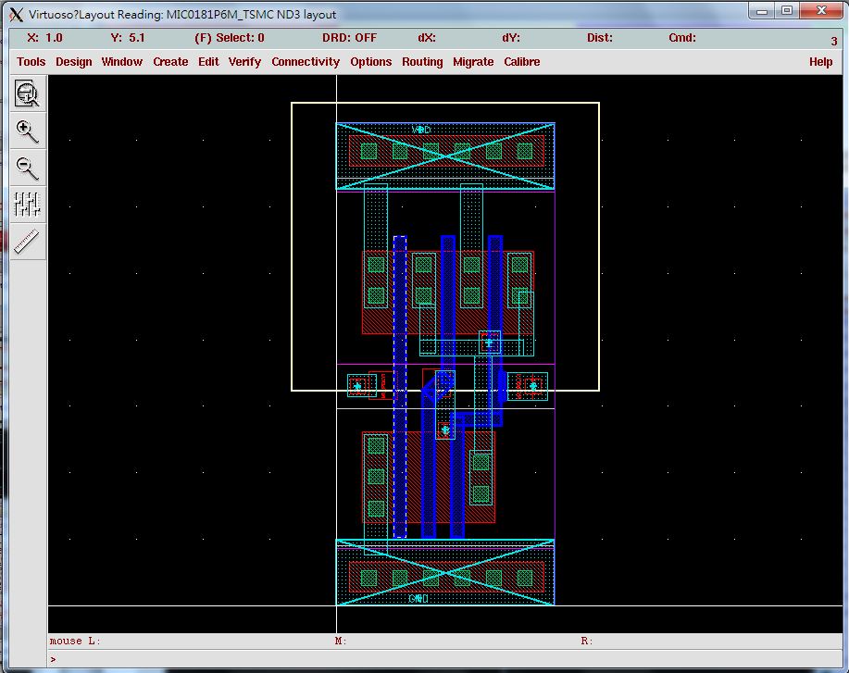
Open a layout (2/2)

Slide 26


Write your netlist file from the layout view
**********************************************
* Main Circuit Netlist:
**********************************************
.subckt ND3 Z A B C
MN0 Z C n01 gnd n w=0.45u l=0.18u
MN2 n12 A gnd gnd n w=0.45u l=0.18u
MN1 n01 B n12 gnd n w=0.45u l=0.18u
MP0 Z A vdd vdd p w=0.9u l=0.18u
MP1 Z B vdd vdd p w=0.9u l=0.18u
MP2 Z C vdd vdd p w=0.9u l=0.18u
.ends ND3
D
S
G
B
G
B
S
D

Slide 27
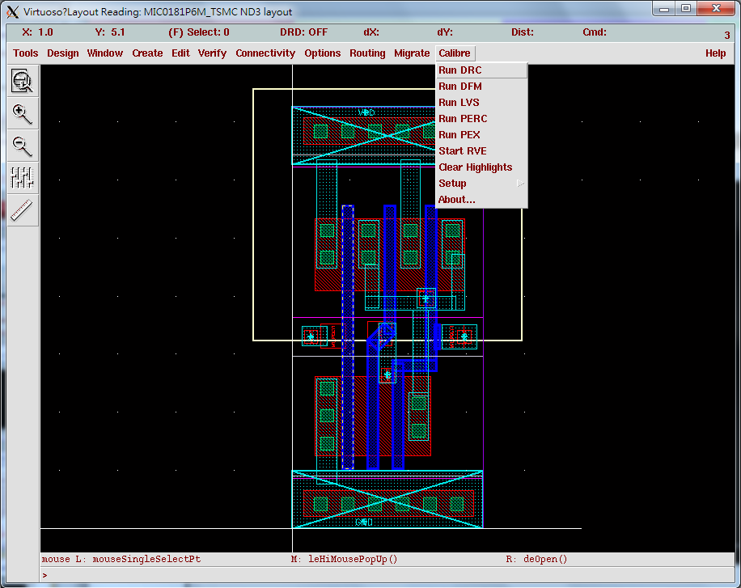
Run Calibre-PEX

Slide 28
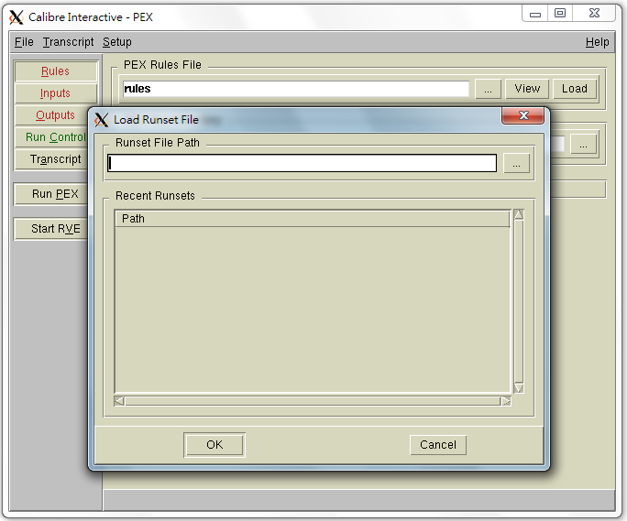
Initialization
Choose Cancel for your first time.
Choose OK if you have saved your setting before.

Slide 29
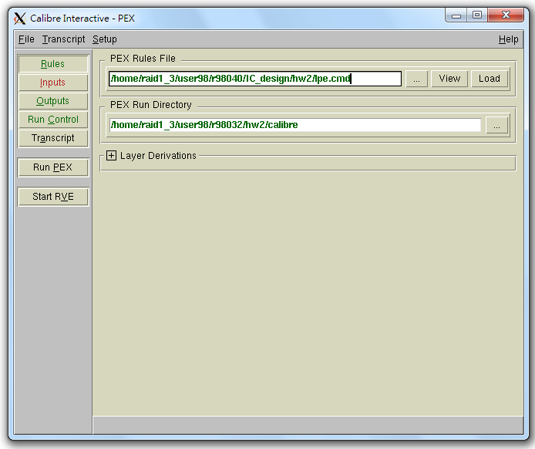
PEX Rule setting
Run the rule file in the TA’s directory!
Specify your run directory

Slide 30
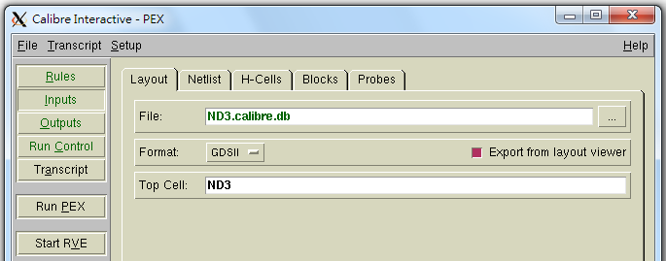
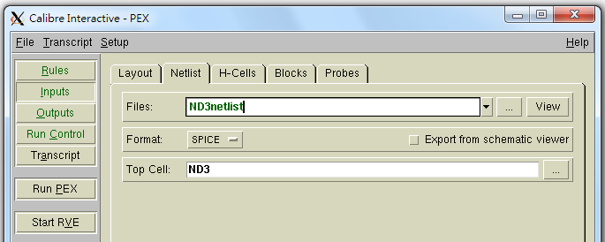
Read Layout view and Netlist file
Make sure your layout view is open!
Specify your netlist file.

Slide 31
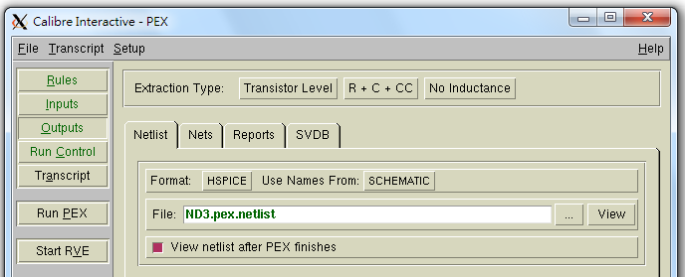
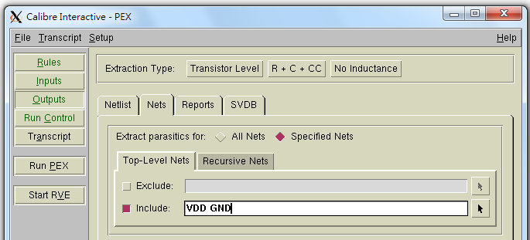
Specify the Output Requirement
The name of your output netlist.

Slide 32
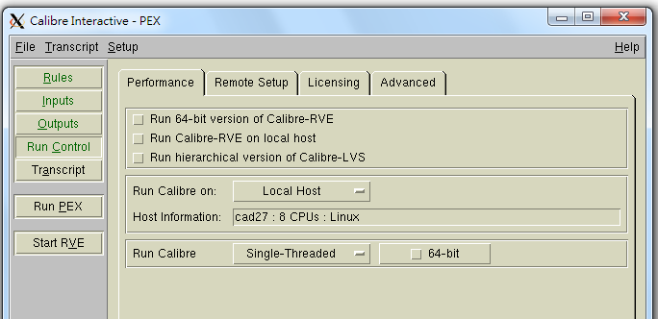
Check run control settings and Run!

Slide 33
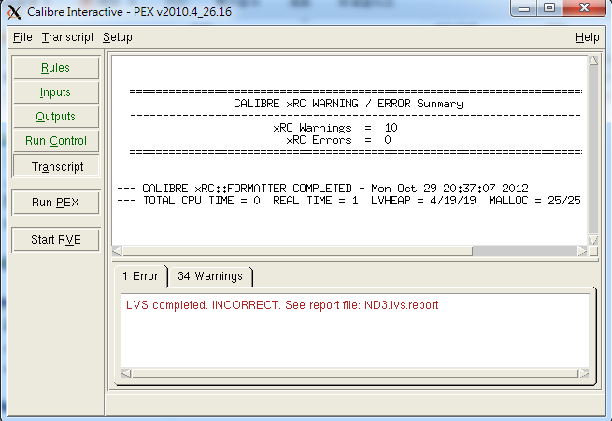
After PEX finishes, check error!

Slide 34
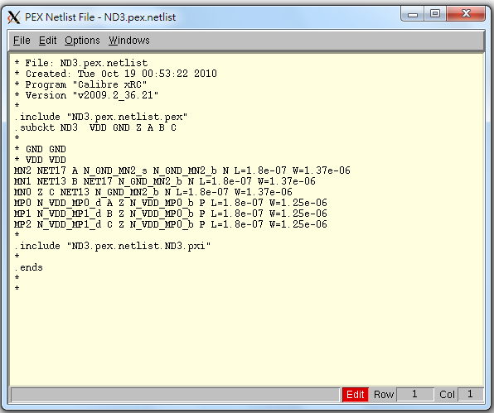
Three output files
Output files:
*.pex.netlist
*.pex.netlist.pex
*.pex.netlist.*.pxi

Slide 35
Post-layout Simulation Tools
Nanosim
SPICE language (Input waveform)

Slide 36
Prepare for simulation
Revise *.pex.netlist (Attention!!)
N → nch
P → pch
Give input voltage source
Piecewise linear voltage source VA connected between node 1 and node 2
VA node1 node2 PWL 0n 0v 30n 0v
+ 30.5n 1.8v 60n 1.8v 60.5n 0v 70n 0v
DC voltage source
VA node1 node2 dc 1.8v
Check Ref[1] for detail
node1
node2

Slide 37
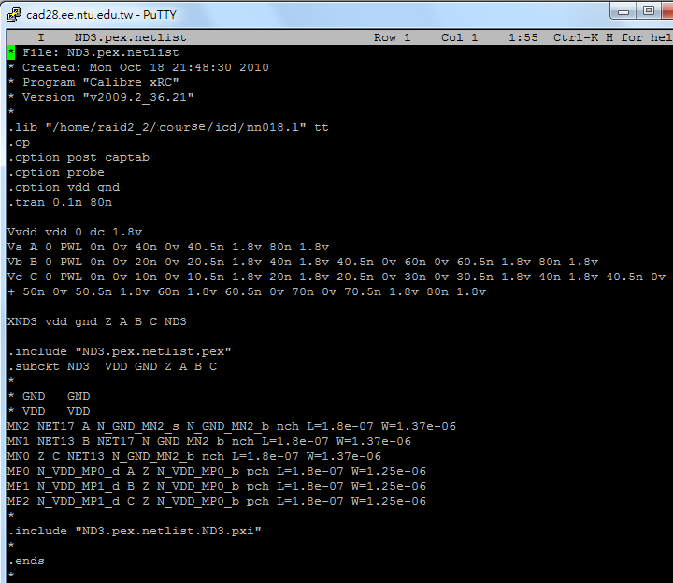
Revision example
Library from TA’s directory
Add setting
Add your input source
N → nch
P → pch

Slide 38
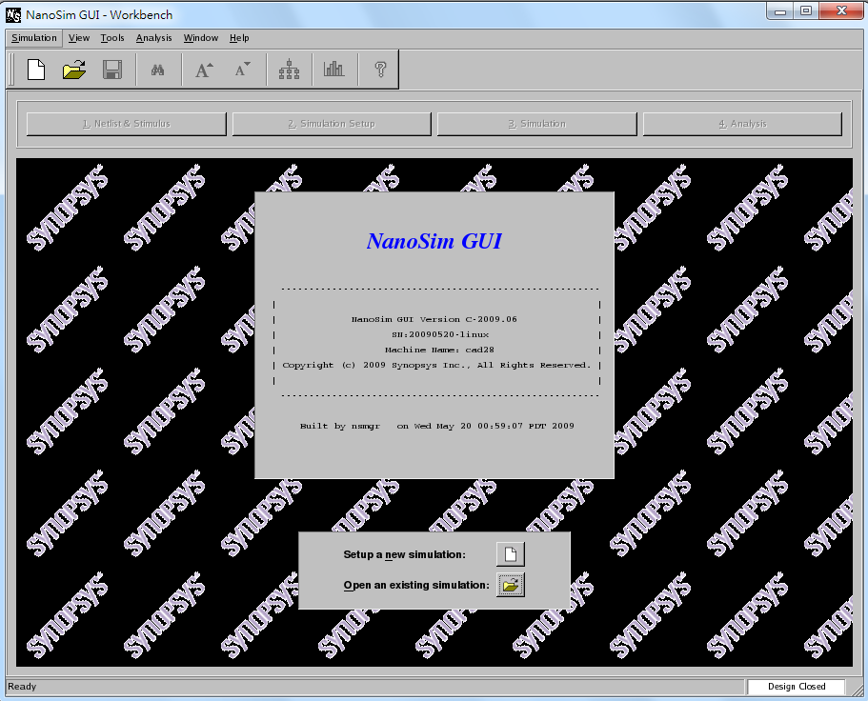
Nanosim: Source file and execute
Source file
source /usr/cad/synopsys/CIC/nanosim.cshrc
Execute
nanosimgui &

Slide 39
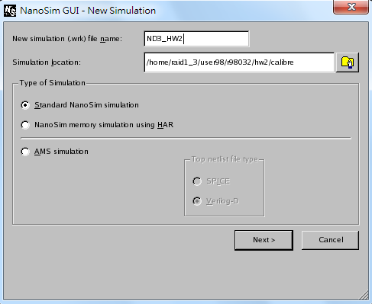
Create a new simulation work
Simulation → new
Give your simulation file name.

Slide 40
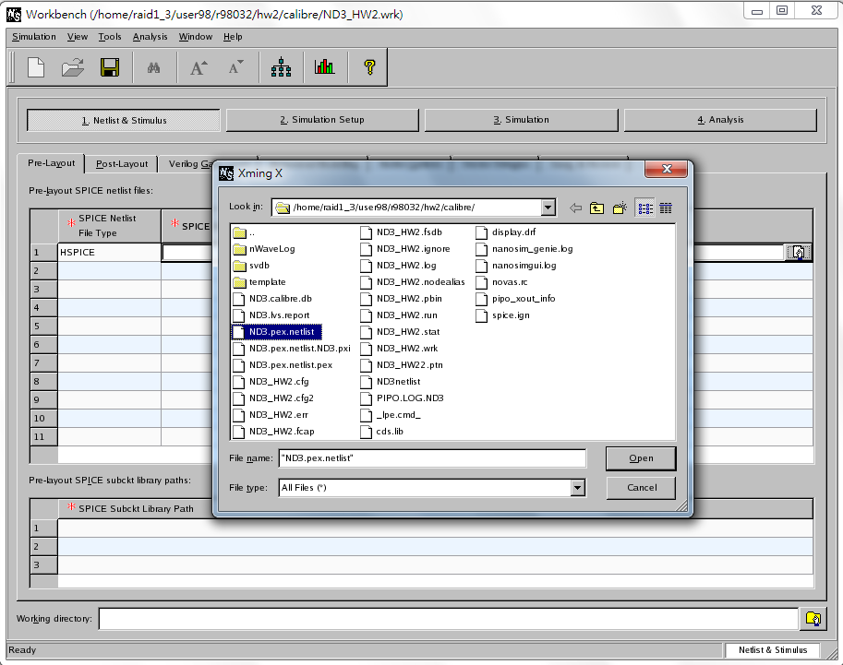
Input *.netlist file
Select your revised netlist from cadence tool.

Slide 41
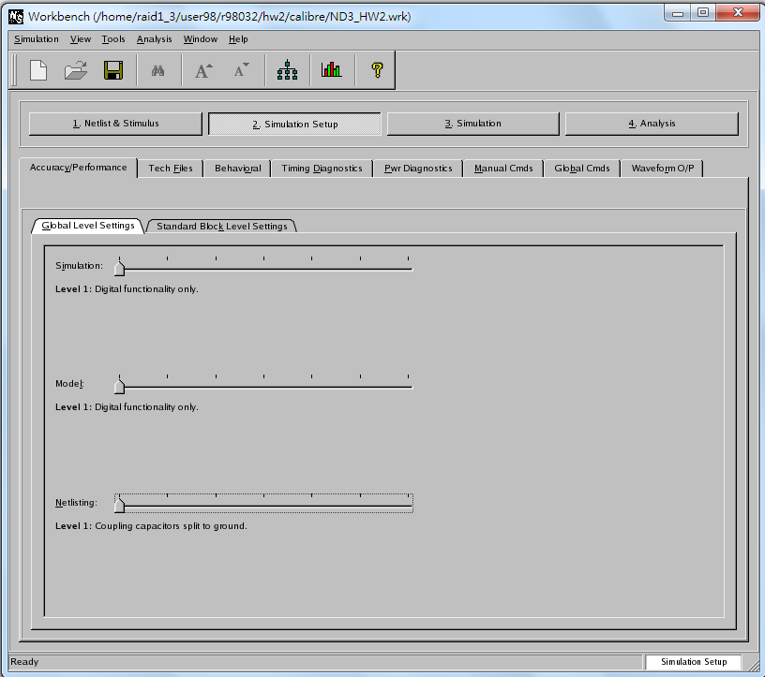
Simulation setup

Slide 42
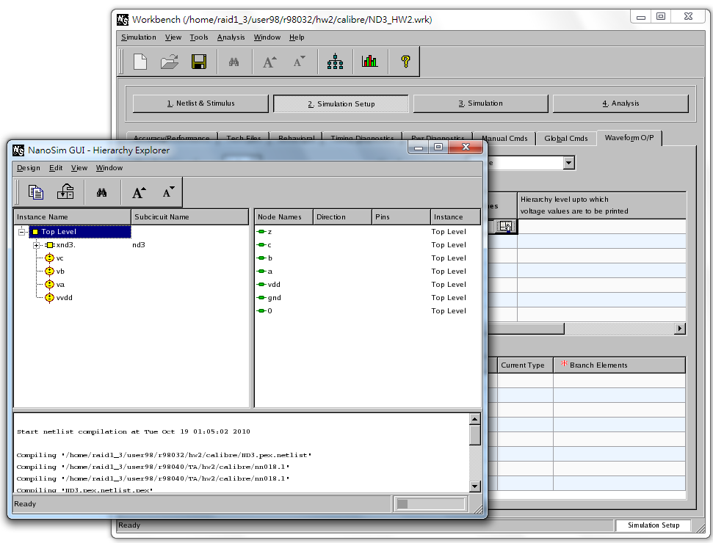
Compile your netlist
Compile message

Slide 43
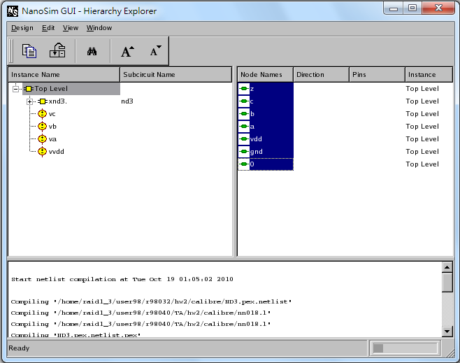
Select the nodes to be observed

Slide 44
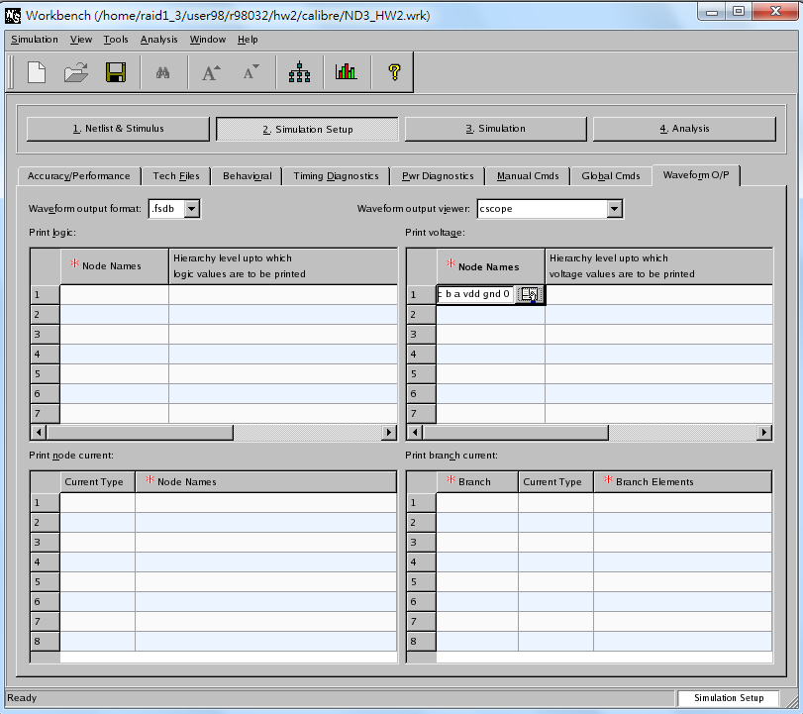
Ready to run simulation

Slide 45
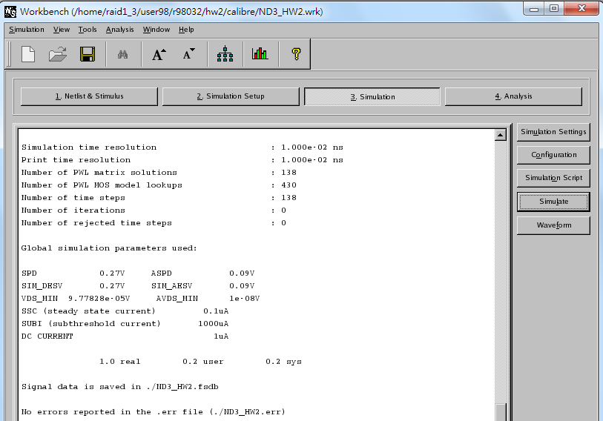
Start simulation
If there is no error, your can check your signal data: *.fsdb file

Slide 46
Debug Tool
nWave

Slide 47
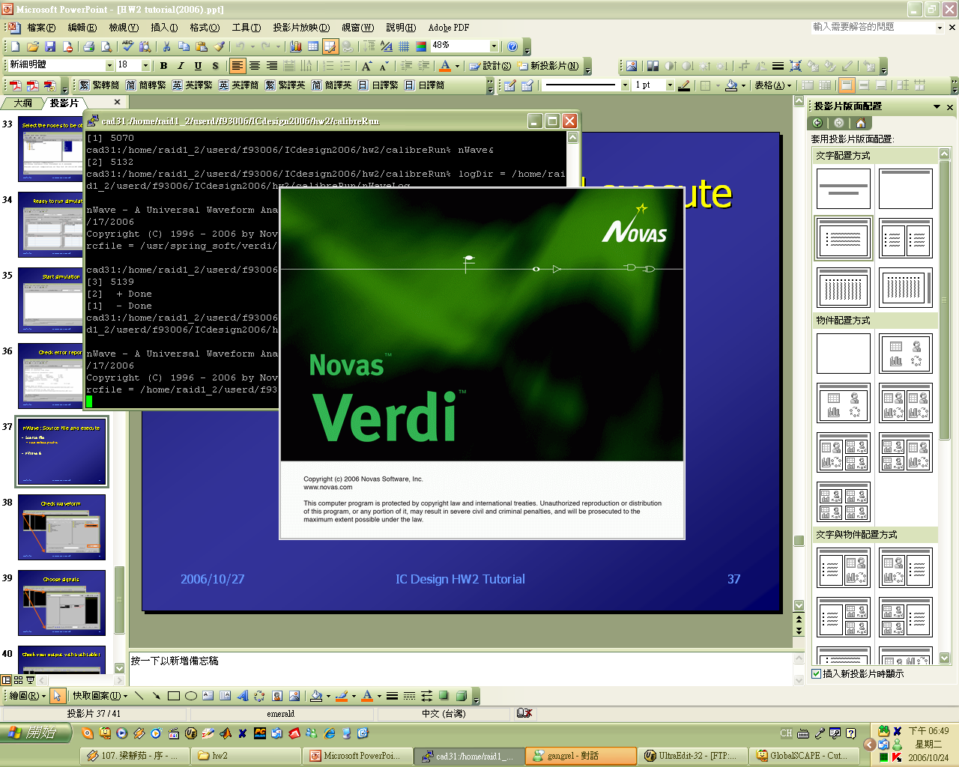
nWave: Source file and execute
Source
source /usr/spring_soft/CIC/verdi.cshrc
Execute nWave
nWave &

Slide 48
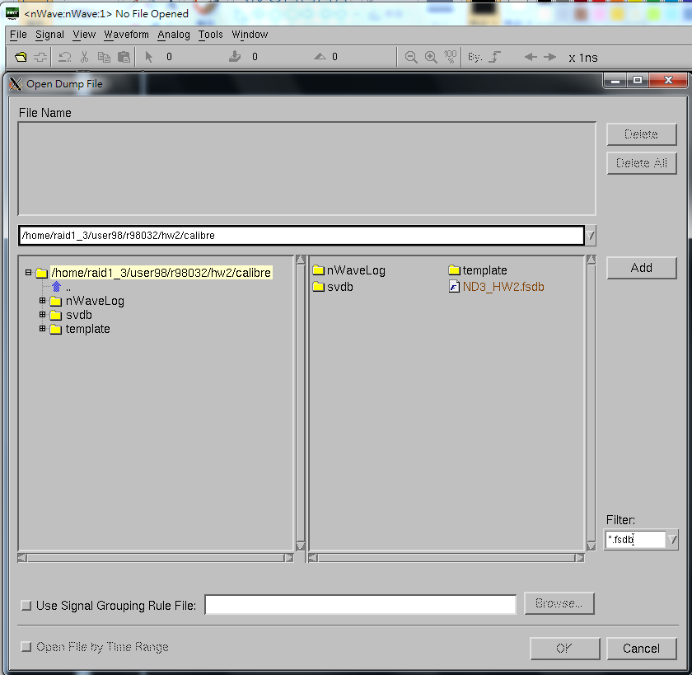
Select output file generated by Nanosim
You can use filter here to get your signal file.

Slide 49
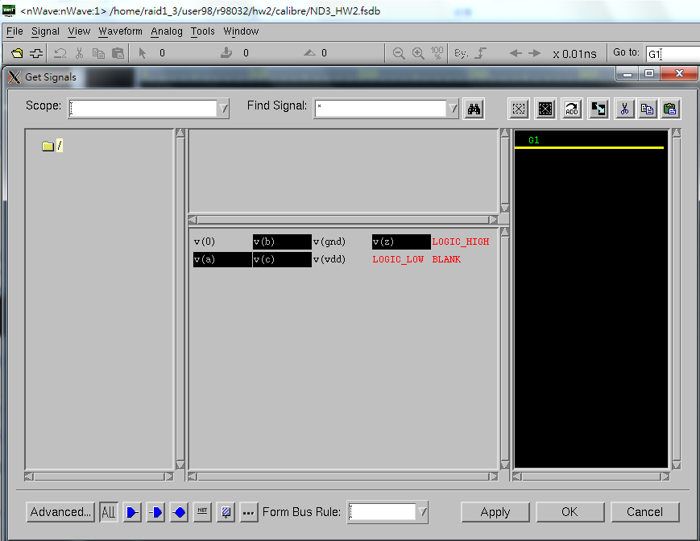
Select desired signals
Select the desired signal.

Slide 50
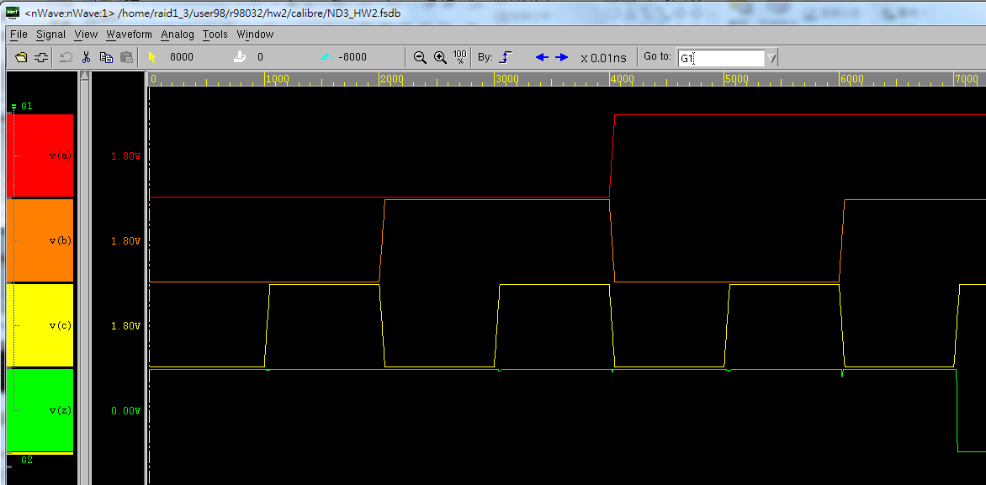
Check your output waveform !

Slide 51
Flow chart
Ex:
ND3.pex.netlist
ND3.pex.netlist.pex
ND3.pex.netlist.ND3.pxi
.netlist .pex .pxi nn018.l
Cadence
Layout
Ex: ND3_HW2.fsdb
*.fsdb
Calibre
Nanosim
nWave
Extraction
Post-layout simulation
Your job
(Write netlist)
netlist
Your job
(Give input)
Ex: ND3netlist

Slide 52
Reminder
Be patient and careful about each step!
References
[1] “SPICE,” CIC handout, 2001
[2] “鳥哥的Linux 私房菜” http://linux.vbird.org/
If you have any questions, please contact…
b96901055@ntu.edu.tw
r00943118@ntu.edu.tw
Specify [IC_Design] before your title
課程網頁→討論看板

Slide 53
Thanks for your attention!
Q & A

